Slide 1
Non-Invasive Blood Pressure Estimation Using Photoplethysmography & IoT-AL Integration
Ridwan Sharif
ID : 213-15-4381
Department : CSE
Daffodil International University
Dr. Arif Mahmud
Associate Professor & Associate Head
Department of CSE
Daffodil International University

Slide 2
Outline
Introduction
Objective
Background Study
Gap Analysis
Methodology
Results & Analysis
Novelty and Uniqueness
Conclusion
References

Slide 3
Introduction
Context: The need for Blood Pressure(BP) monitoring has grown, as hypertension is a leading cause of cardiovascular disease.[1]
Aim: To design an IoT-based, non-invasive BP monitoring system using photoplethysmography (PPG) signals and machine learning models.
System Components: IoT device with MAX30102 PPG sensor, ESP32 microcontroller, and Machine Learning for BP prediction.

Slide 4
Objective
To Undertake a critical evaluation of state-of-the-art in PPG-based blood pressure measurement
To Develop an end-to-end system architecture combining wearable PPG sensors, IoT protocols, and cloud-based AI models.
To Design a signal processing pipeline for PPG data & Propose an ML/DL model architecture for accurate Systolic and Diastolic Blood Pressure (SBP/DBP) prediction.

Slide 5
Background Study
Author(s) | Year | Title | Methodology | Key Findings
Dai, D. et al.[2] | 2024 | Non-Invasive Continuous Blood Pressure Estimation from Single-Channel PPG Based on a Temporal Convolutional Network Integrated with an Attention Mechanism | TCN with Convolutional Block Attention Module (CBAM) on the UCI dataset. | DBP estimation met the AAMI standard (MAE 2.12 mmHg); SBP did not (MAE 5.35 mmHg). TCN-CBAM outperformed other ML/DL models.
Tarifi, B. et al.[3] | 2023 | A Machine Learning Approach to the Non-Invasive Estimation of Continuous Blood Pressure Using Photoplethysmography | Four neural networks for SBP, DBP, MAP, and waveform prediction on MIMIC-III data. | SBP (MAE 5.26 mmHg) and DBP (MAE 2.96 mmHg) results met international standards. Novel separation of discrete value prediction from waveform shape prediction.

Slide 6
Background Study
Author(s) | Year | Title | Methodology | Key Findings
Wong, M. K. F. et al.[4] | 2023 | Applied machine learning for blood pressure estimation using a small, real-world electrocardiogram and photoplethysmogram dataset | Compared RF, SVR, Adaboost, and ANN on a small, noisy dataset (n=54) using ECG+PPG features. | SVR performed best on noisy data (MAE 6.97 mmHg), meeting BHS Level C criteria. Demonstrated feasibility on real-world ambulatory data.
Mohammadi, H. et al.[5] | 2025 | Cuff-less blood pressure monitoring via PPG signals using a hybrid CNN-BiLSTM deep learning model with an attention mechanism | Hybrid CNN-BiLSTM with attention mechanism on a large MIMIC-II dataset (2064 patients). | Achieved very high accuracy with MAE of 1.88 mmHg for SBP and 1.34 mmHg for DBP, underscoring potential for scalable wearable solutions.

Slide 7
Background Study
Author(s) | Year | Title | Methodology | Key Findings
Chowdhury, M.H. et al.[6] | 2020 | Estimating Blood Pressure from the Photoplethysmogram Signal and Demographic Features Using Machine Learning Techniques | Gaussian Process Regression (GPR) with 107 extracted features (demographic, time/frequency domain, statistical). | GPR with ReliefF feature selection yielded high accuracy (RMSE 6.74 SBP, 3.59 DBP). Complied with BHS Grade B.
Slapničar, G. et al.[7] | 2019 | Blood Pressure Estimation from Photoplethysmogram Using a Spectro-Temporal Deep Neural Network | Custom ResNet architecture using 5s PPG waveform and its derivatives as input. | MAEs of 9.4 mmHg (SBP) and 6.9 mmHg (DBP) did not meet clinical standards, but the work was a valuable guide due to its large dataset (510 patients) and detailed methodology.

Slide 8
Gap Analysis
Calibration Challenges: Most cuffless BP devices still require regular calibration, reducing autonomy and negating seamless monitoring.
Validation and Standardization Issues: Lack of universal validation standards leads to inflated performance claims and unreliable results due to small datasets and data leakage.
Motion Artifacts in Real-World Use: Models trained in controlled settings fail to perform well in real-world conditions due to motion artifacts and poor sensor contact.
Limited Use of Demographic Data: Most models rely only on PPG signals, ignoring key factors like age, gender, and BMI, which affect BP accuracy.
Security and Privacy Gaps: Insufficient focus on IoT security and data protection (e.g., HIPAA, GDPR), crucial for handling sensitive health data.

Slide 9
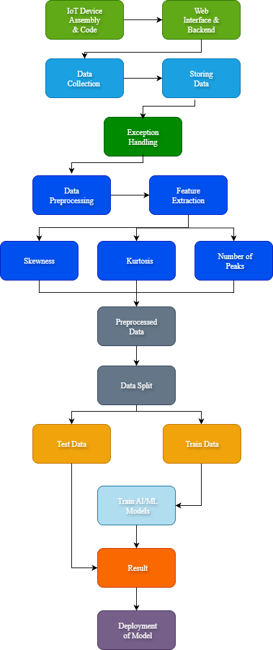
Methodology
IoT Device Setup:
Data collection using the MAX30102 PPG sensor integrated with ESP32 microcontroller.
IoT protocols for secure transmission of PPG data to the cloud.
Use of real-time monitoring and data collection without the need for traditional cuff-based methods.
Data Preprocessing:
Raw PPG data is cleaned by removing noise and irrelevant features.
Feature extraction includes extracting heart rate, SpO2, and other vital metrics from the PPG signal.
Machine Learning and Deep Learning Models:
Application of Random Forest, XGBoost, AdaBoost, LightGBM, and CatBoost for BP prediction.
Ensemble models to combine predictions for improved accuracy.
Evaluation of models using performance metrics such as MAE, RMSE, R², and MAPE.
Fig 1: Proposed Methodology

Slide 10
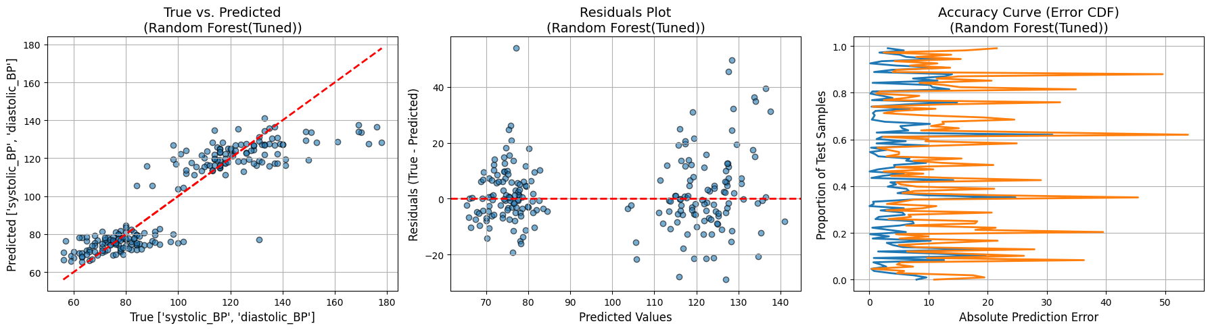
Result and Analysis
Fig 2: Random Forest Performance plot and curve

Slide 11
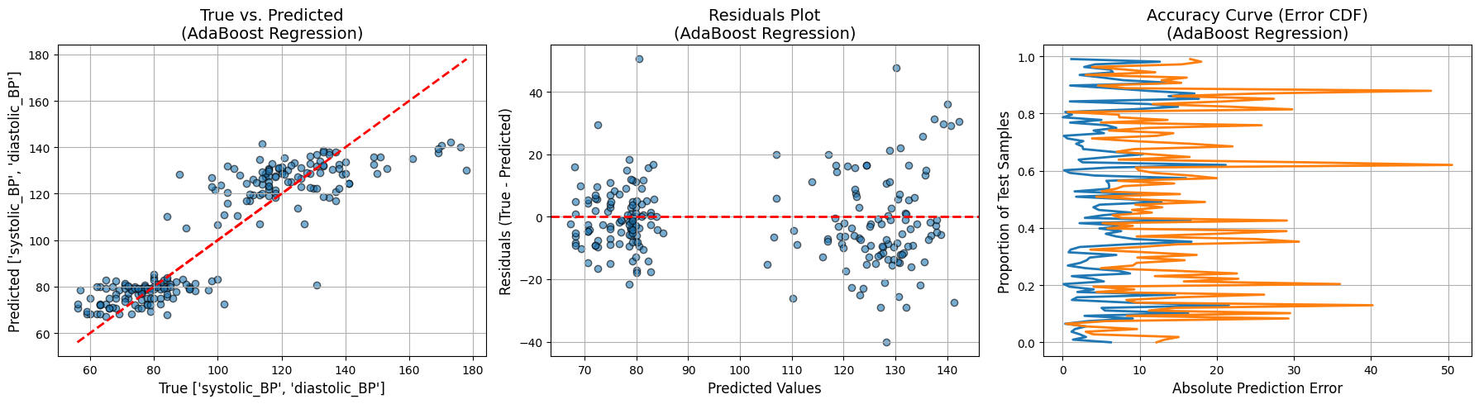
Result and Analysis
Fig 3: Ada Boost Performance plot and curve

Slide 12
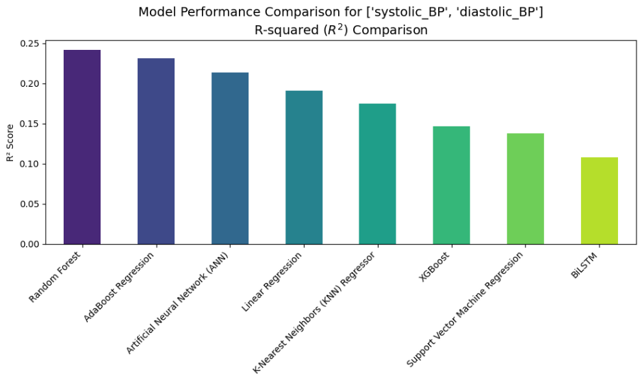
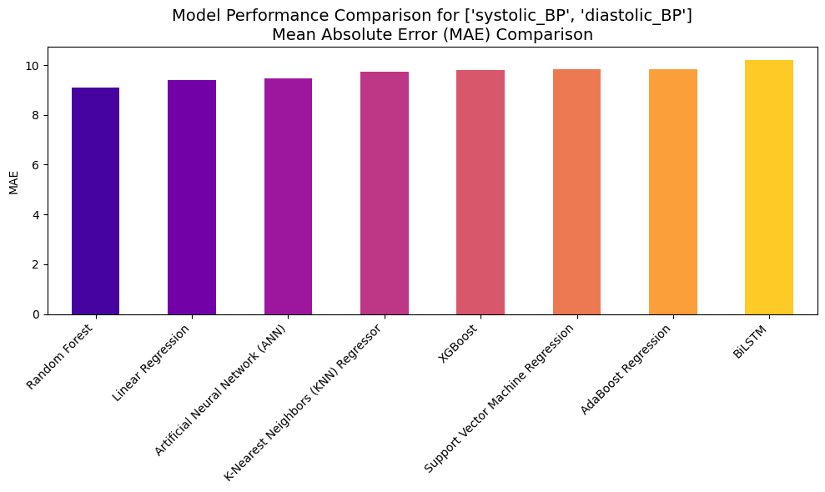
Result and Analysis
Fig 4: R-squared model preference Bar Chart
Fig 4: MAE model preference Bar Chart

Slide 13
Result and Analysis
Table 1: Performance Analysis Table of Models
Model | MAE | MSE | RMSE | R² | MAPE (%)
Linear Regression | 9.4 | 175.70 | 13.25 | 0.191040 | 9.17
Random Forest | 9.08 | 165.73 | 12.87 | 0.241600 | 8.83
XGBoost | 9.78 | 185.26 | 13.61 | 0.146234 | 9.61
Artificial Neural Network (ANN) | 9.45 | 168.82 | 12.99 | 0.213652 | 9.19
BiLSTM | 10.21 | 198.62 | 14.09 | 0.107857 | 10.0
K-Nearest Neighbors (KNN) Regressor | 9.73 | 181.11 | 13.45 | 0.175010 | 9.52
Support Vector Machine Regression (SVR) | 9.82 | 194.18 | 13.93 | 0.137424 | 9.49
AdaBoost Regression | 9.84 | 170.29 | 13.04 | 0.230850 | 9.87

Slide 14
Novelty and Uniqueness
Innovative Approach:
IoT integration with PPG sensors for continuous blood pressure monitoring.
Use of machine learning and ensemble methods to improve prediction accuracy.
Uniqueness:
The system is portable and non-invasive, allowing for real-time BP monitoring without the need for traditional cuff-based measurements.

Slide 15
Conclusion
Random Forest achieved the best performance, but models struggled due to sensor noise and dataset biases.
Data Bias: The dataset had a lack of diversity, especially in terms of age and gender.
Sensor Quality: The non-medical-grade sensor led to noisy PPG readings.
Upgrade to medical-grade sensors for better data accuracy.
Miniaturize the system to a finger-clip size similar to an oximeter.
Deploy models directly onto microcontrollers for on-device inference

Slide 16
References
[1] World Health Organization. (2021). World health statistics 2021: Monitoring health for the SDGs. https://www.who.int/data/gho/publications/world-health-statistics
[2] Dai, D., Ji, Z., & Wang, H. (2024). Non-Invasive Continuous Blood Pressure Estimation from Single-Channel PPG Based on a Temporal Convolutional Network Integrated with an Attention Mechanism. Applied Sciences, 14(14), 6061.
[3] Tarifi, B., Fainman, A., Pantanowitz, A., & Rubin, D. M. (2023). A Machine Learning Approach to the Non-Invasive Estimation of Continuous Blood Pressure Using Photoplethysmography. Applied Sciences, 13(6), 3955.
[4] Wong, M. K. F., Hei, H., Lim, S. Z., & Ng, E. Y. K. (2023). Applied machine learning for blood pressure estimation using a small, real-world electrocardiogram and photoplethysmogram dataset. Mathematical Biosciences and Engineering, 20(1), 975-997.

Slide 17
References
[5] Mohammadi, H., Tarvirdizadeh, B., Alipour, K., & Ghamari, M. (2025). Cuff-less blood pressure monitoring via PPG signals using a hybrid CNN-BiLSTM deep learning model with attention mechanism. Scientific Reports.
[6] Chowdhury, M. H., Shuzan, M. N. I., Chowdhury, M. E., Mahbub, Z. B., Uddin, M. M., Khandakar, A., & Reaz, M. B. I. (2020). Estimating Blood Pressure from the Photoplethysmogram Signal and Demographic Features Using Machine Learning Techniques. Sensors, 20(11), 3127.
[7] Slapničar, G., Mlakar, N., & Luštrek, M. (2019). Blood Pressure Estimation from Photoplethysmogram Using a Spectro-Temporal Deep Neural Network. Sensors, 19(15), 3420.

Slide 18
THANK YOU

